Slide 1
NATIONAL SCHOLARSHIP PORTAL
GROUP – 8
GROUP MEMBERS:
Ritam Chakladar - 10711455
Ashok J - 10711854
Jovita DLima - 10711959
Prashant Chauhan - 10711651
GUIDE
Mr. Sajeed Sheikh

Slide 2
INTRODUCTION
In today's world, the cost of education has drastically increased, thereby hindering the education of children belonging to low-income families.
To help such students continue their education, the government offers various scholarships that help the students financially.
Different education scholarships offered by the government help such students to continue their higher education by reducing the cost of various courses.
The Government has various portals where students can apply for scholarships, such as National Scholarship Portal.

Slide 3
OBJECTIVES
The National Scholarship portal aims to:
Help students pursue further education
Provide an easy and efficient way for students to apply for scholarships
Increase efficiency and speed up the process of scholarship applications
Avoid fake/duplicate applicants

Slide 4
PROJECT DESCRIPTION
The National Scholarship Portal is an education portal that is developed for students to apply for scholarships in an easy and efficient manner.
This Portal offers various scholarships based on different criteria such as merit, minority communities, and has scholarships for female students to encourage them to pursue their education.
The schemes offered on the portal are as follows:
Post Matric Scholarship
National Merit Scholarship
Central Scholarship Scheme

Slide 5
PROJECT DESCRIPTION
Using the National Scholarship Portal, students can directly connect to the government system and browse through and avail various scholarships.
The portal ensures that the scholarship will be granted to the student only after verifying that the student meets the criteria mentioned for the scholarship.
The modules involved in our project are as follows:
Student module
Institute module
State Nodal Officer
Ministry

Slide 6
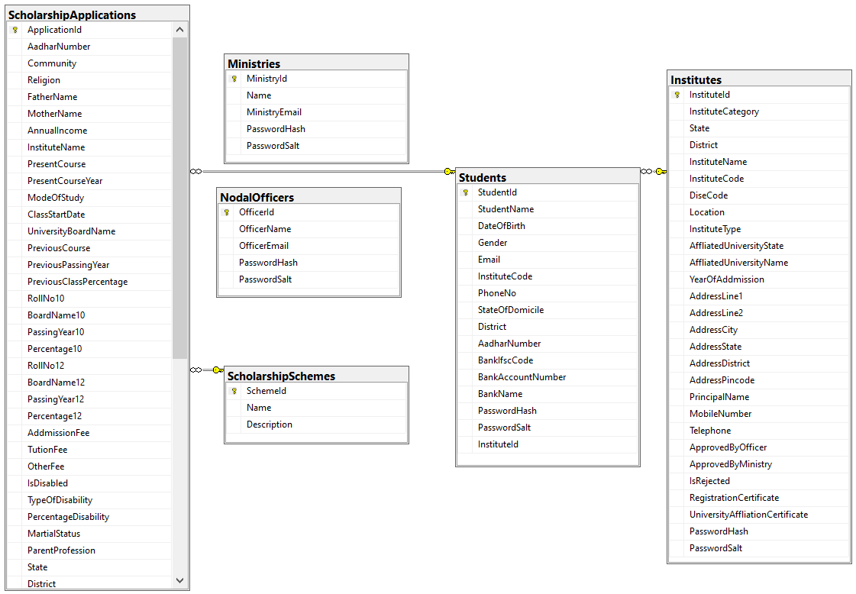
DATABASE DESIGN

Slide 7
WORKING OF MODULES
STUDENT MODULE
New Student
Register
Login
Choose Scheme
Eligible
Scholarship
Granted
Yes
Sent for approval
Fill Application
Form
No
Application
Rejected

Slide 8
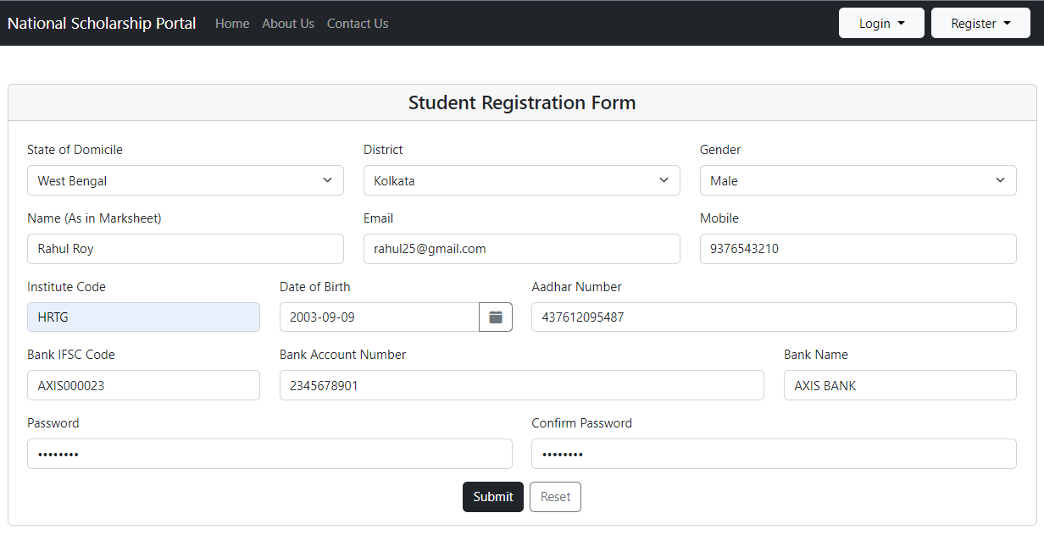
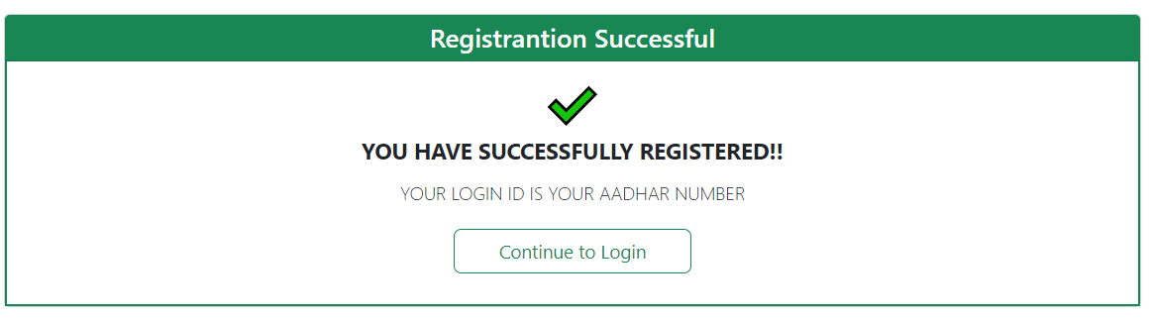
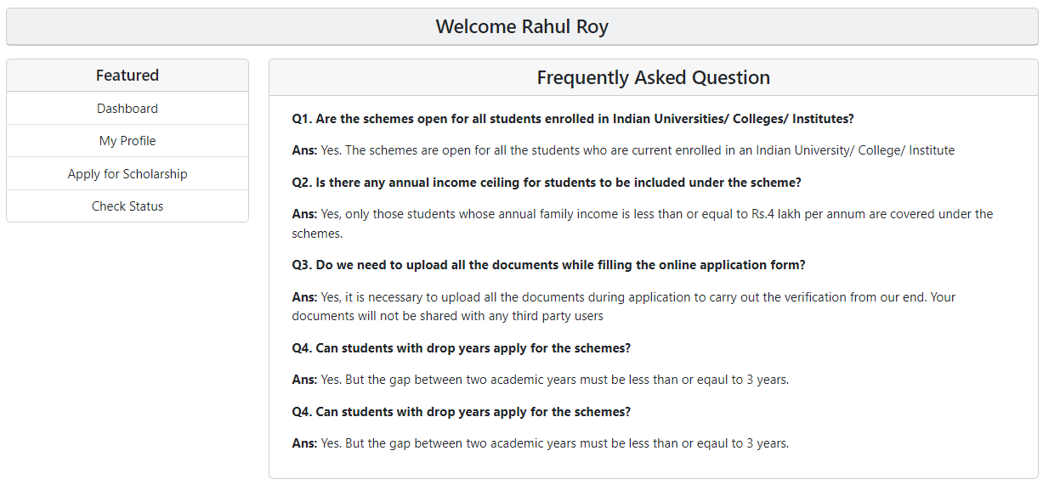
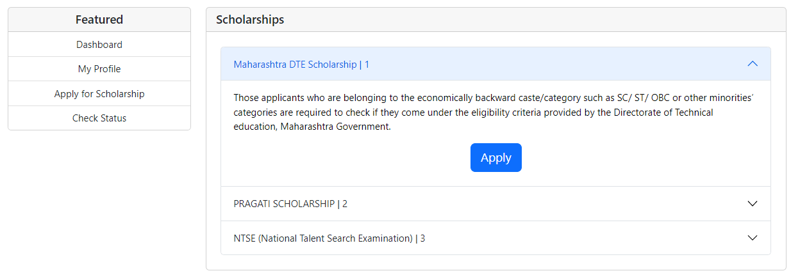
STUDENT MODULE SCREENS

Slide 9
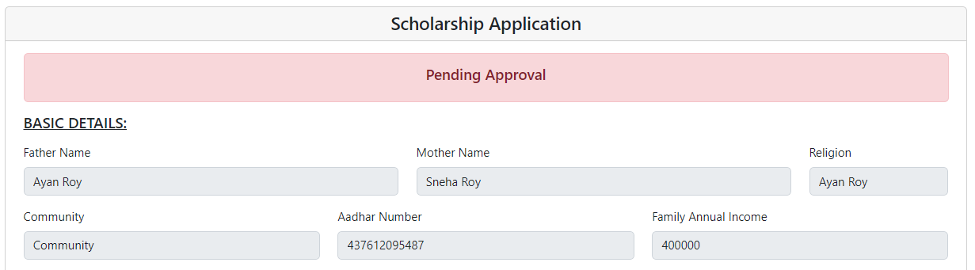
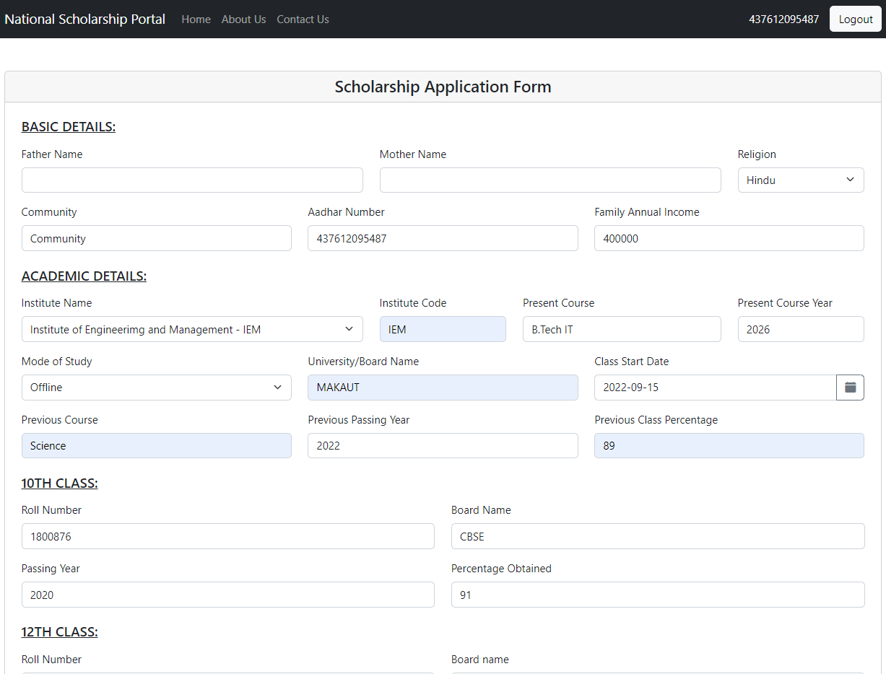
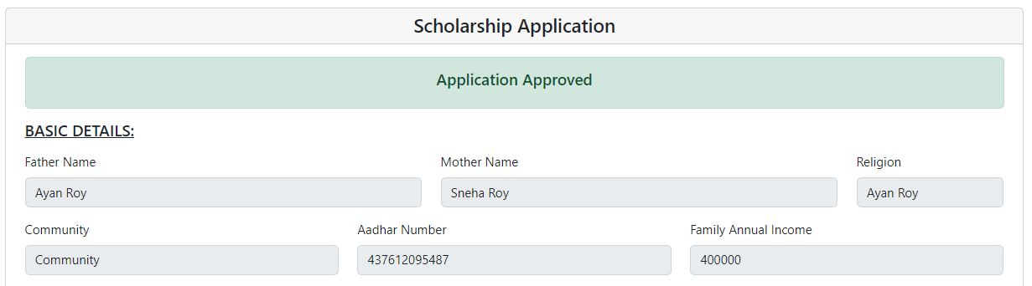

STUDENT MODULE SCREENS

Slide 10
WORKING OF MODULES
INSTITUTE MODULE
INSTITUTE
REGISTER
FORM SENT TO NODAL OFFICER
INVALID
VALIDITY
REJECTED
VALID
VALID
APPROVED
VALIDITY
SENT TO MINISTRY
INVALID
REJECTED

Slide 11
WORKING OF MODULES
INSTITUTE MODULE
LOGIN
FETCH FORMS
INVALID
INSTITUTE
VERIFICATION OF DETAILS
REJECTED
VALID
FORWARDS STUDENT APPLICATION FORM AND BONAFIDE TO NODAL OFFICER

Slide 12
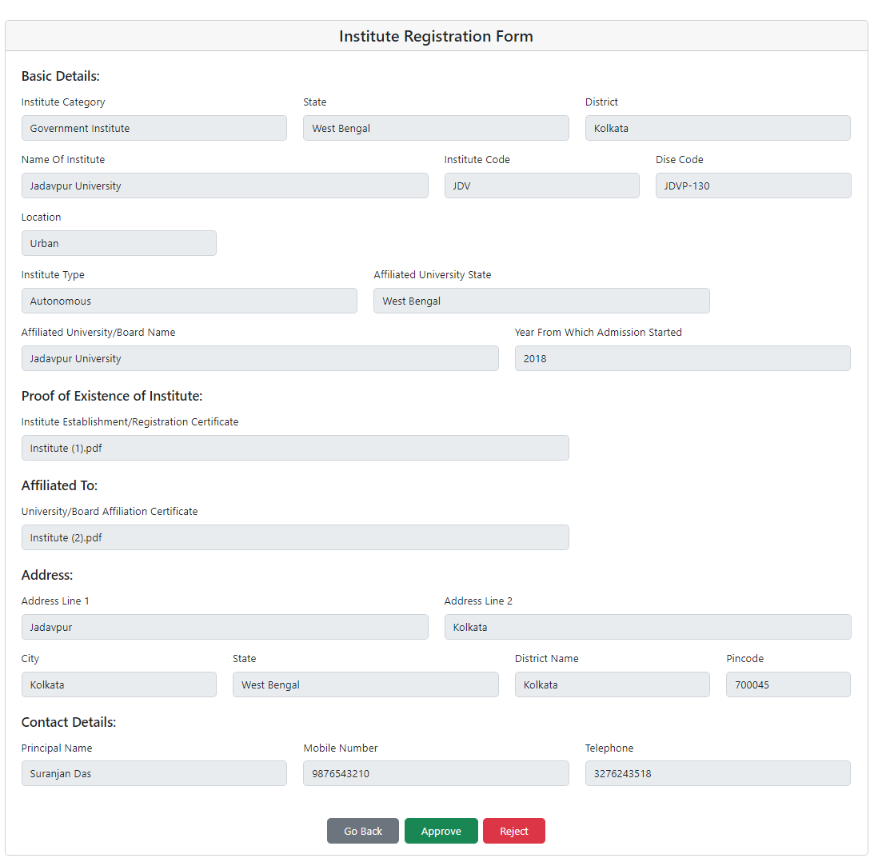
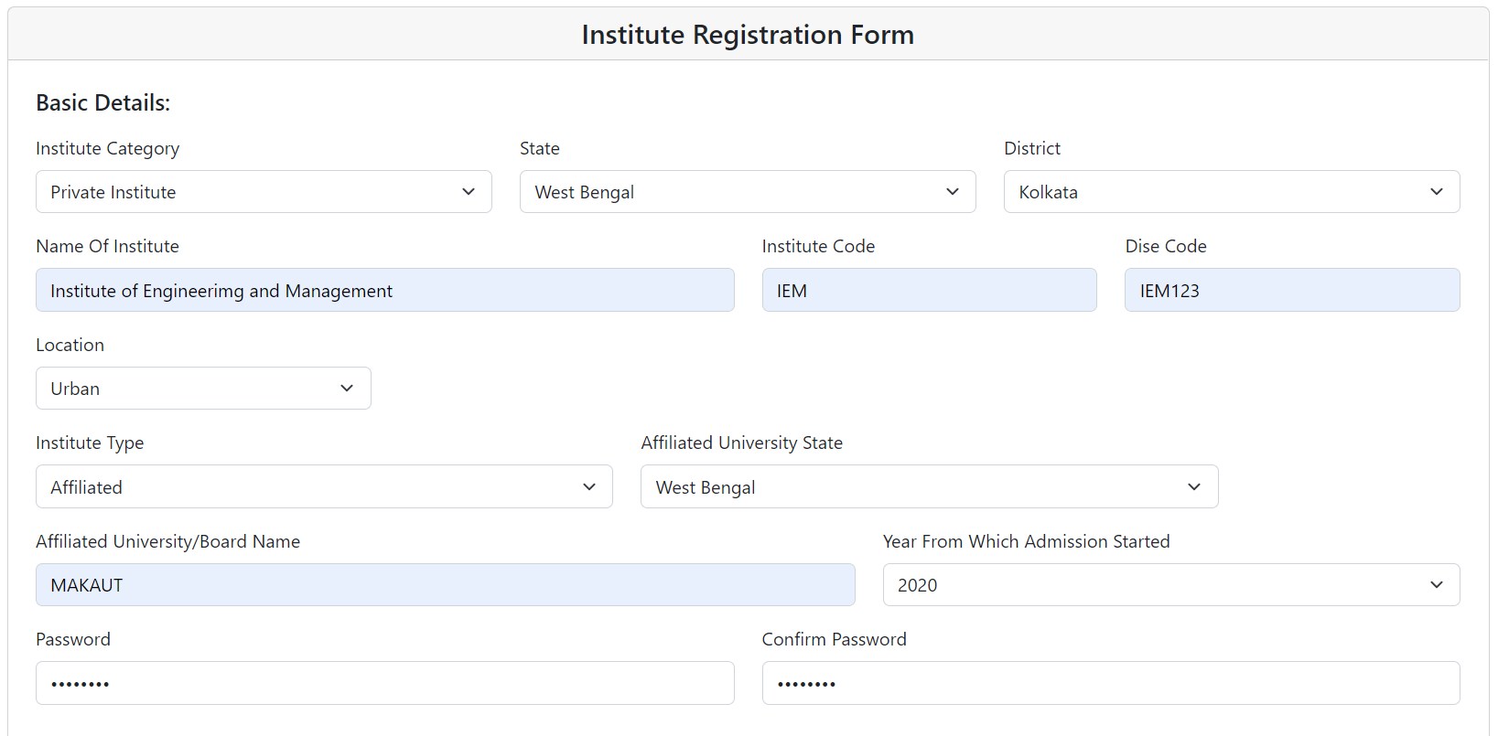
INSTITUTE MODULE SCREENS

Slide 13
WORKING OF MODULES
NODAL OFFICER MODULE
FETCH STUDENT APPLICATION FORMS
INVALID
NODAL OFFICER
VERIFICATION
REJECTED
FETCH INSTITUTE FORMS
VALID
VALID
VERIFICATION
FORWARDS TO MINISTRY
FORWARDS TO MINISTRY
INVALID
REJECTED

Slide 14
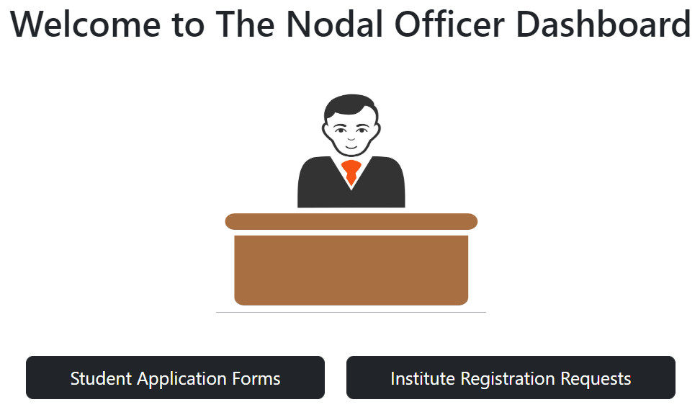
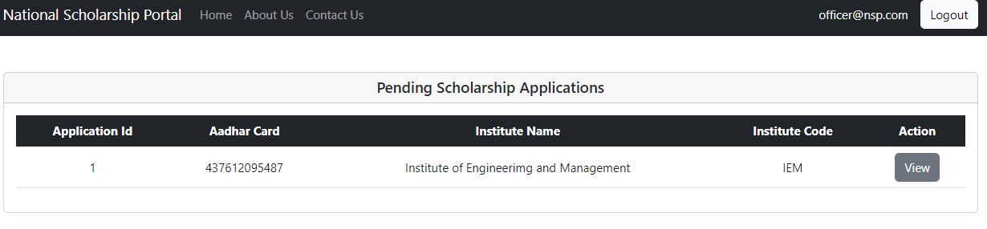
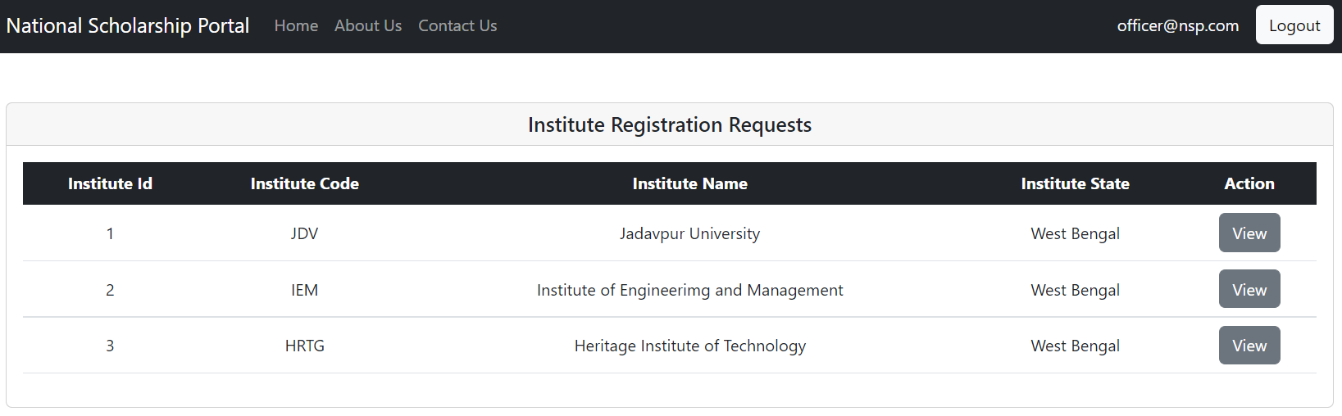
OFFICER MODULE SCREENS

Slide 15
WORKING OF MODULES
MINISTRY MODULE
MINISTRY
FETCH STUDENT APPLICATION FORMS
VIEW APPLICATION FORMS APPROVED BY NODAL
REJECT
FETCH INSTITUTE FORMS
GRANT
APPROVE
REJECT

Slide 16
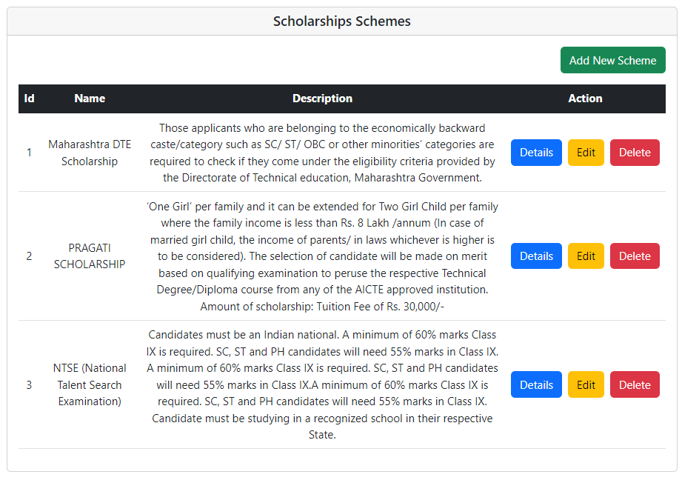
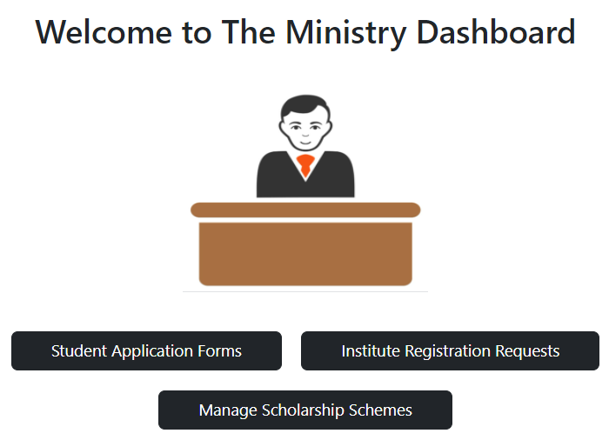
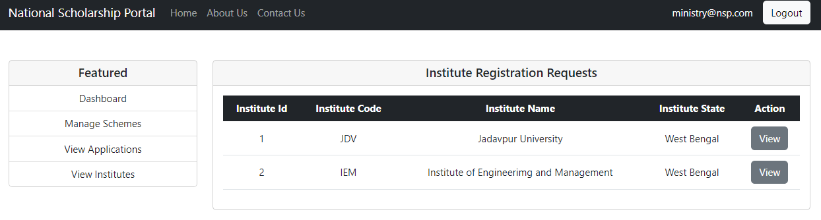
MINISTRY MODULE SCREENS

